Slide 1
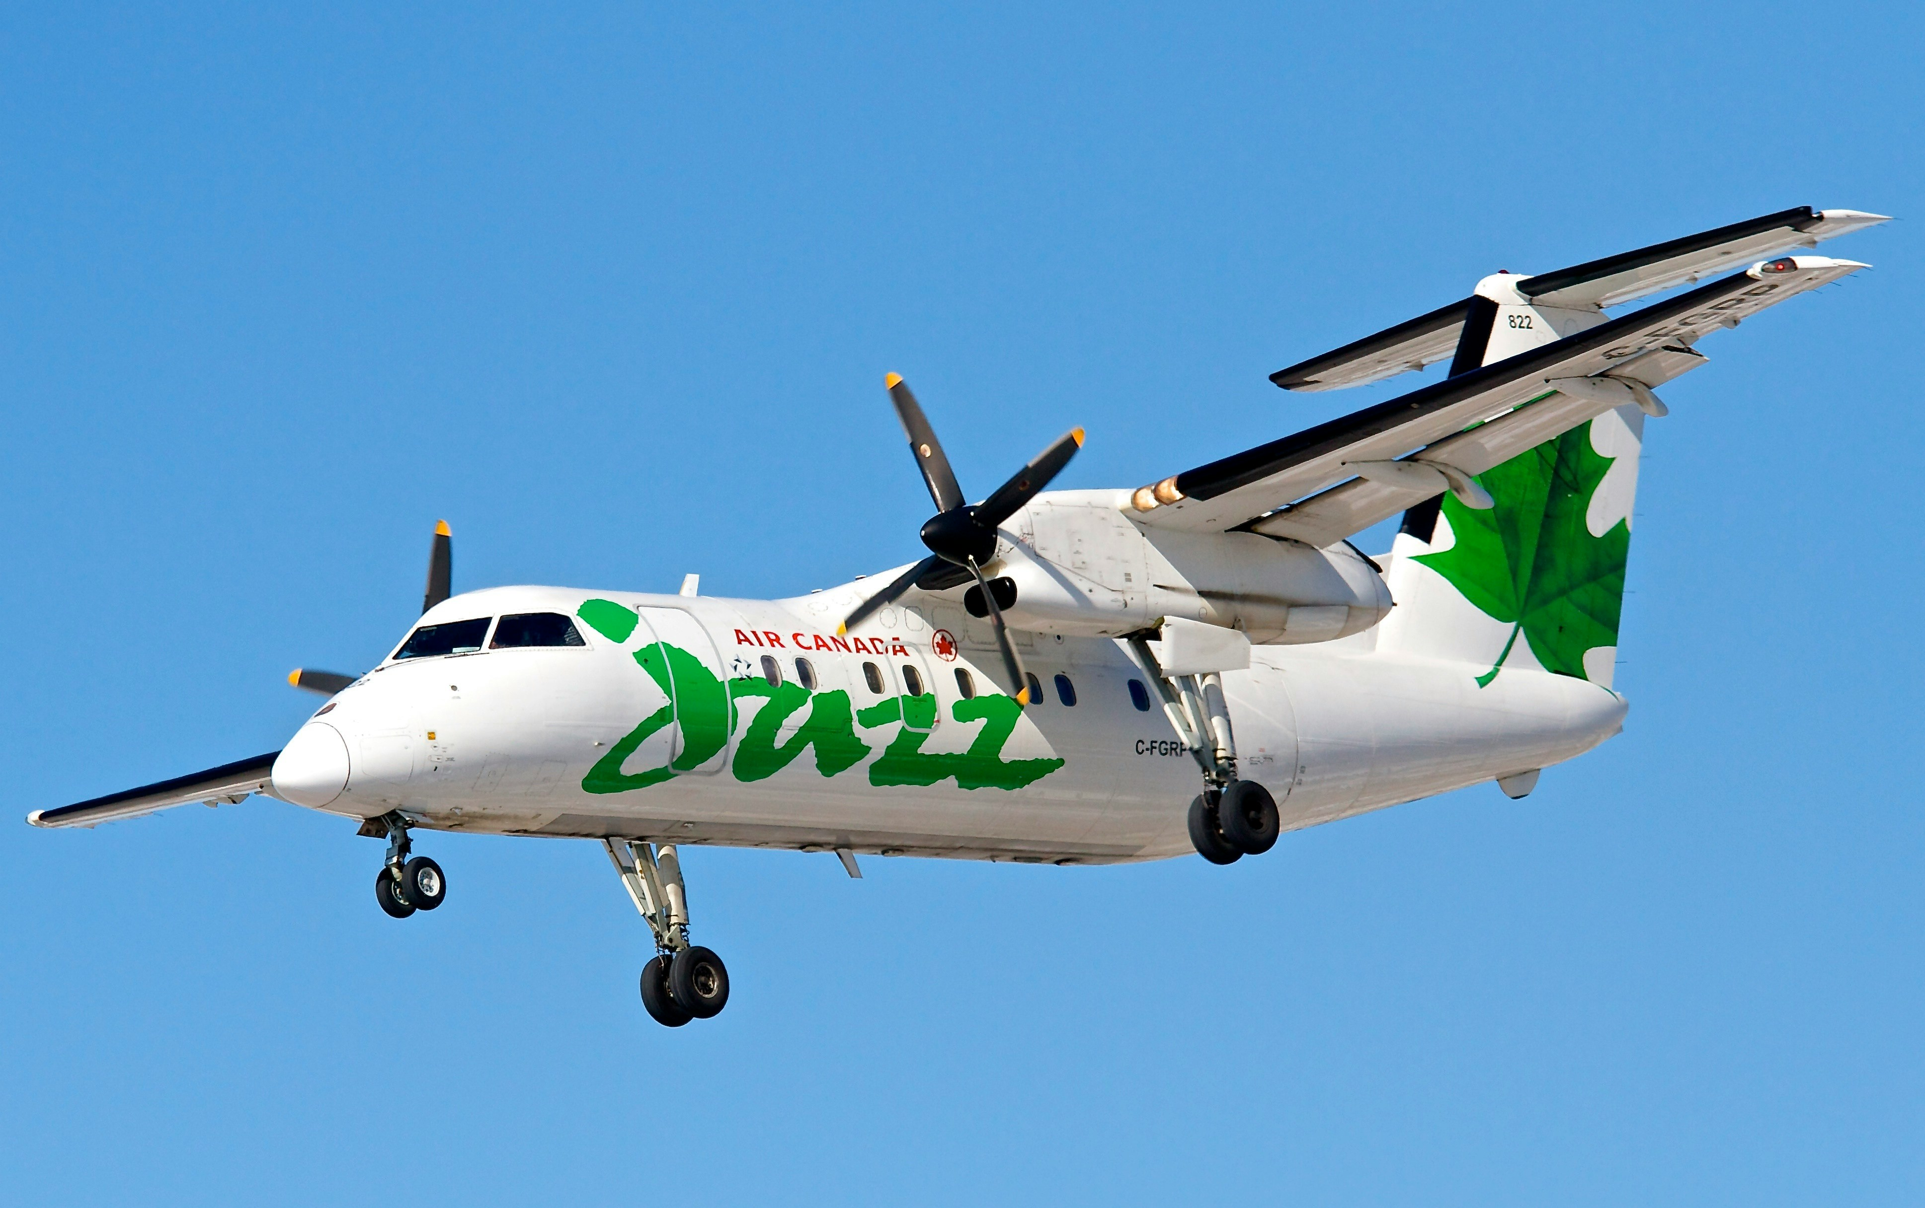
Airline Ticket Price Management

Slide 2
Abstract
Flight ticket fare is the most fluctuating data which varies every day. Depending on the various factors that affect it directly or indirectly.
we cannot say that the price of flight ticket fare remains the same or not. It is quite a tough task to predict the flight ticket fare.
It may change throughout the week, month or some days, but it can be predicted nearly accurate to the actual flight ticket fare.

Slide 3
Introduction
Nowadays, the airline corporations are using complex strategies for theflight ticket fare calculations. This highly complicated methods makes theflight ticket fare difficult to guess for the customers, since the fare changesdynamically.
Our project Improved Flight Price Prediction System which resolve thisproblem and provide a facility where people will be able to predict theflight-ticket price before purchasing the ticket.

Slide 4
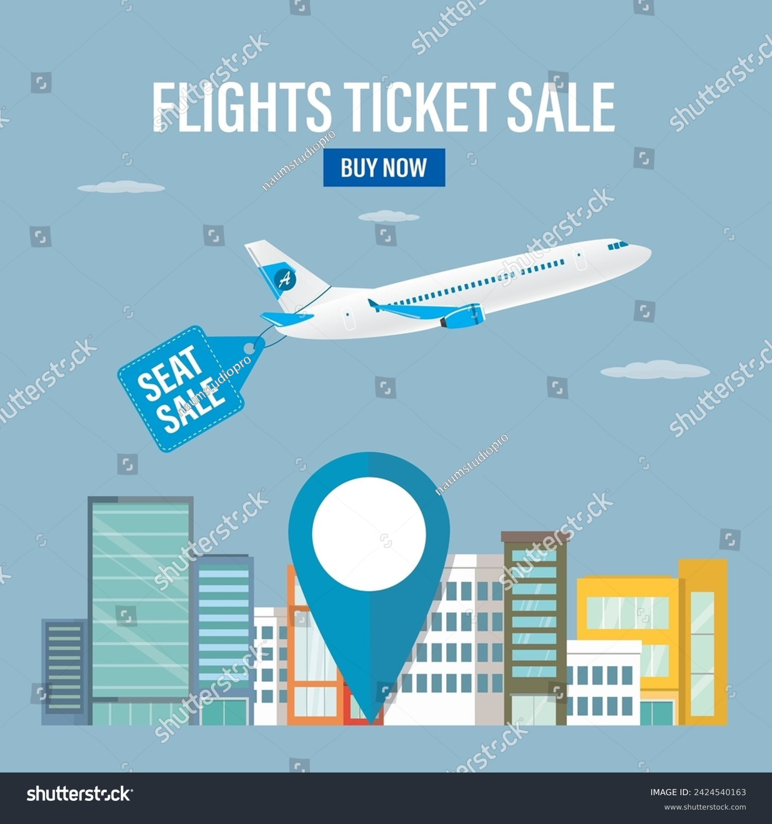
Objective
The prime objective of this project is to use machine learning techniques to model the behavior of flight ticket prices over the time and predict the price of the flight-ticket. The goal of this project is to study how airline ticket prices change over time, extract the factors that influence these fluctuations, and describe how they recorrelated (essentially guess the models that air carriers use to price their tickets)

Slide 5
About Project
Flight ticket price is something hard to guess therefore we are presentingour model which can predict the price of upcoming flight tickets.
By usingmachine learning we are implementing our project. Here we haveapplied Extreme Gradient Boosting algorithm. In our project we havecreated a web page which takes the input from the user.
The inputcontains source, destination, date and the user will select the airline ofwhose ticket he wants to predict. After giving the input the user can viewthe result of predicted price which was the result of our model.

Slide 6
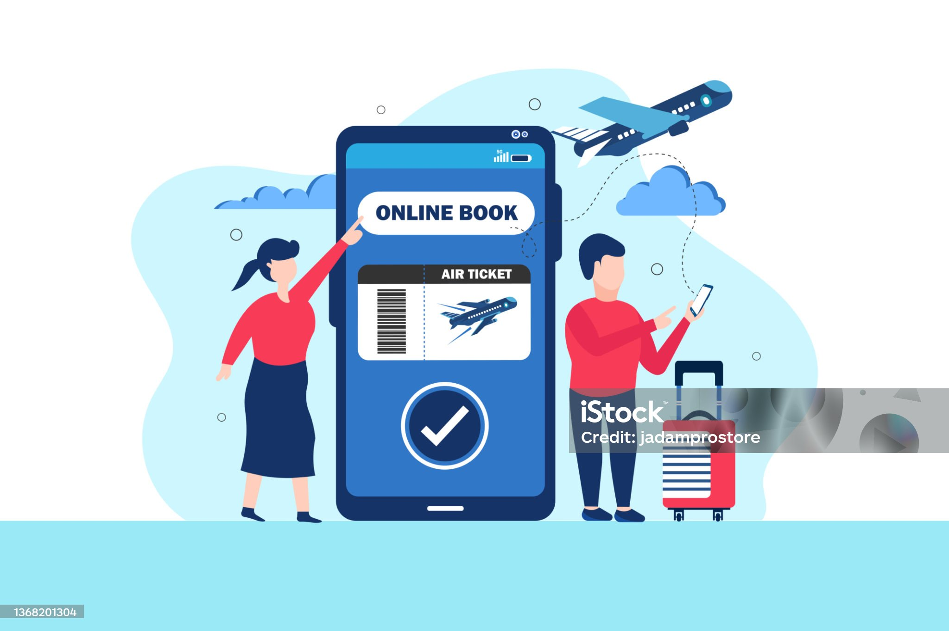
Scope
For purchasing an airplane ticket, the traditional purchase strategy is to buy a ticketfar in advance of the
flight’s
departure date to avoid the risk that the price may increase rapidly before the departure date. However, this is usually not always true, airplane companies can decrease the prices if they want to increase the sales.
Airline companies use many different variables to determine the flight ticket prices that indicates whether the travel is during the holidays, the number of free seats in the plane etc., or even in which month it is, some of the variables are observed, but some of them are hidden.
In this context, buyers are trying to find the right day to buy the ticket, and on the contrary, the airplane companies are trying to keep the overall revenue as high as possible. Airline companies have the freedom to change the flight ticket prices at any moment. Travelers can save money if they choose to buy a ticket when its price is the lowest.

Slide 7
Technology Stack
Technology
jdk 1.8
core java
jdbc
mysql
lambok
software tool
eclips

Slide 8
Flowchart

Slide 9
ER Digram

